Slide 1
JavaScript’s First Lesson

Slide 2
Questions
Are you familiar with Programming?
Which programming languages do you know?
How much would you rate yourself in JavaScript out of 10?
How much would you rate yourself in Python out of 10?

Slide 3
Why Learn JavaScript?
JavaScript is the world's most popular programming language.
JavaScript is the programming language of the Web.
JavaScript is easy to learn.
JavaScript is one of the 3 languages all web developers must learn:
1. HTML to define the content of web pages
2. CSS to specify the layout of web pages
3. JavaScript to program the behavior of web pages

Slide 4
What is “document”?
In the JavaScript environment, an HTML page is represented by a variable called “document”.
What does this document contain?
Ans: A tree of elements
HTML
BODY
P
SCRIPT

Slide 5
A couple of things to begin with that you can do with JavaScript
JavaScript Can Change HTML Content
JavaScript Can Change HTML Attribute Values
JavaScript Can Change HTML Styles (CSS)
JavaScript Can Hide HTML Elements
JavaScript Can Show HTML Elements

Slide 6
Where To Run JavaScript Code
The <script> Tag
In HTML, JavaScript code is inserted between <script> and </script> tags.
Example:
<script>
document.getElementById("demo").innerHTML = "My First JavaScript";
</script>
JavaScript Functions and Events:
A JavaScript function is a block of JavaScript code, that can be executed when "called" for.
For example, a function can be called when an event occurs, like when the user clicks a button.

Slide 7
An Example
<!DOCTYPE html>
<html>
<head>
<script>
function myFunction() {
document.getElementById("demo").innerHTML = "Paragraph changed.";
}
</script>
</head>
<body>
<h2>Demo JavaScript in Head</h2>
<p id="demo">A Paragraph</p>
<button type="button" onclick="myFunction()">Try it</button>
</body>
</html>

Slide 8
Have you any of experience of coding in JavaScript?
VSCode is not an environment. It is an editor.
What was the environment you were coding in?
Like: Console, or Browser, Node.js
What is a Developer Console (or DevTools) in Browser?

Slide 9
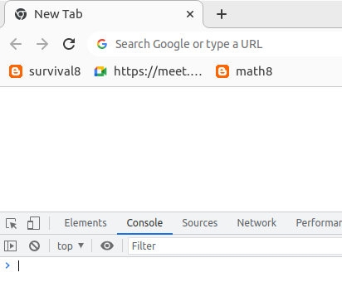
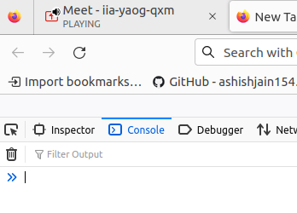

Slide 10
Where to run the JavaScript code?
In console
In browser
In Node.js environment

Slide 11
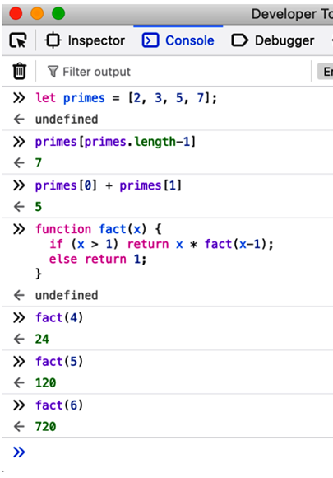
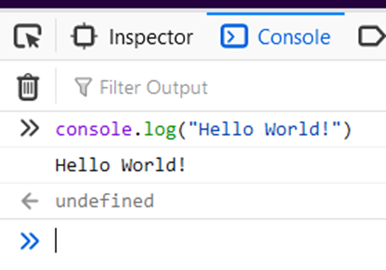
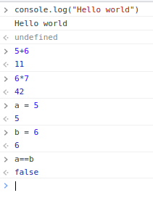
In Console

Slide 12
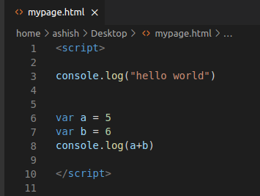
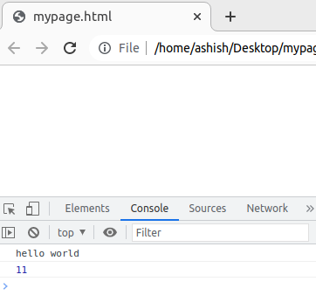
In Browser

Slide 13
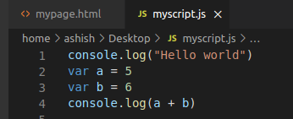
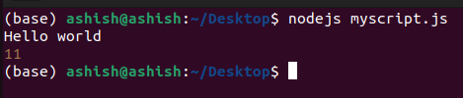
In Node.js
Installing Node.js on Ubuntu
$ sudo apt install nodejs
$ sudo apt install npm

Slide 14
Thank you!

